Slide 1
Problems on Catch

Slide 2
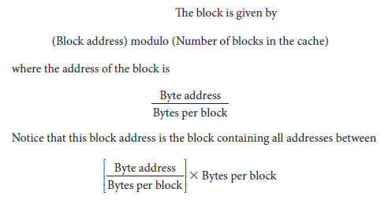
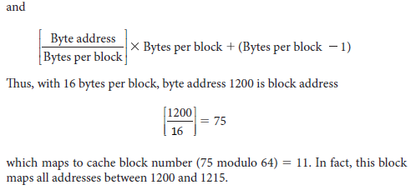
Example 1. Consider a cache with 64 blocks and a block size of 16 bytes. To what block number does byte address 1200 map?

Slide 3
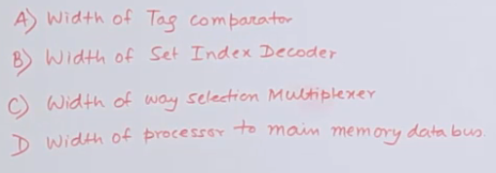
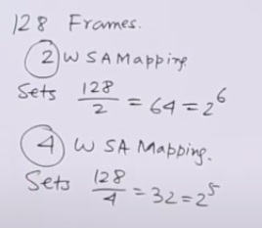
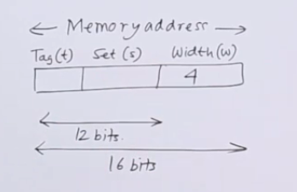
Example 2.

Slide 4
Handling Catch Miss
Cache miss: A request for data from the cache that cannot be filled because the data is not present in the cache.
The cache miss handling is done in collaboration with the processor control unit and with a separate controller that initiates the memory access and refills the cache.
Stall the processor.

Slide 5
The steps to be taken on an instruction cache miss:
Send the original PC value (current PC – 4) to the memory.
2. Instruct main memory to perform a read and wait for the memory to complete its access.
3. Write the cache entry, putting the data from memory in the data portion of the entry, writing the upper bits of the address (from the ALU) into the tag field, and turning the valid bit on.
4. Restart the instruction execution at the first step, which will refetch the instruction, this time finding it in the cache.

Slide 6
Handling Writes
Consider a store instruction.
We wrote the data into only the data cache, without changing main memory.
Memory would have a different value from that in the cache.
The cache and memory are said to be inconsistent.
Write-through: A scheme in which writes always update both the cache and the next lower level of the memory hierarchy, ensuring that data is always consistent between the two.
Slow process.

Slide 7
Cont’d.
Write buffer: A queue that holds data while the data is waiting to be written to memory.
After writing the data into the cache and into the write buffer, the processor can continue execution.
When a write to main memory completes, the entry in the write buffer is freed.
What if the write buffer is full?
Stall the processor.
If the rate at which the memory can complete writes is less than the rate at which the processor is generating writes.

Slide 8
Cont’d.
The alternative to a write-through scheme is a scheme called write-back.
Write-back A scheme that handles writes by updating values only to the block in the cache, then writing the modified block to the lower level of the hierarchy when the block is replaced.

